Slide 1
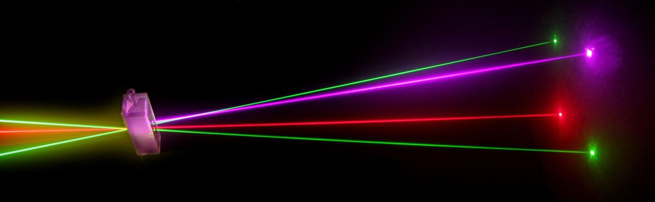
“Laser Technology and Applications” 16B1NPH533 Lecture 32

Slide 2
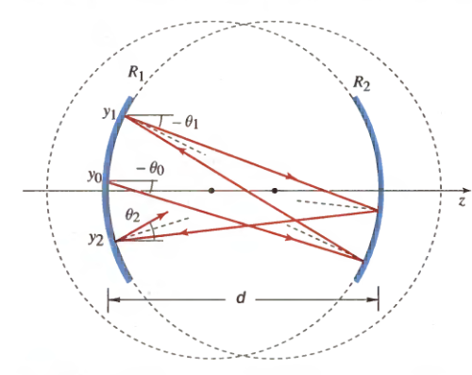
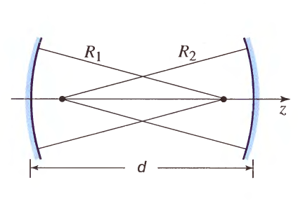
Lecture 32 Content Outlines
ABCD Matrix: Ray Confinement

Slide 3
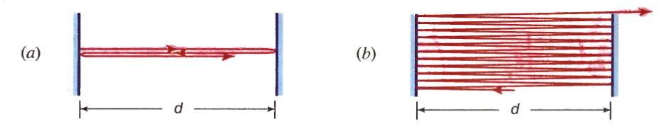
(a) Light rays perpendicular to the mirrors reflect back and forth without escaping. (b) Rays that are only slightly inclined eventually escape. Rays also escape if the mirrors are not perfectly parallel.
The position and inclination of a ray after m round trips are represented by y_{m} and θ_{m} respectively, where m = 0, 1, 2, ... In this diagram, θ_{m} < 0 since the ray is directed downward. Angles are exaggerated for the purposes of illustration; all rays are paraxial so that sin θ ≈ tan θ ≈θ and the propagation distance of all rays between the mirrors is d.

Slide 4
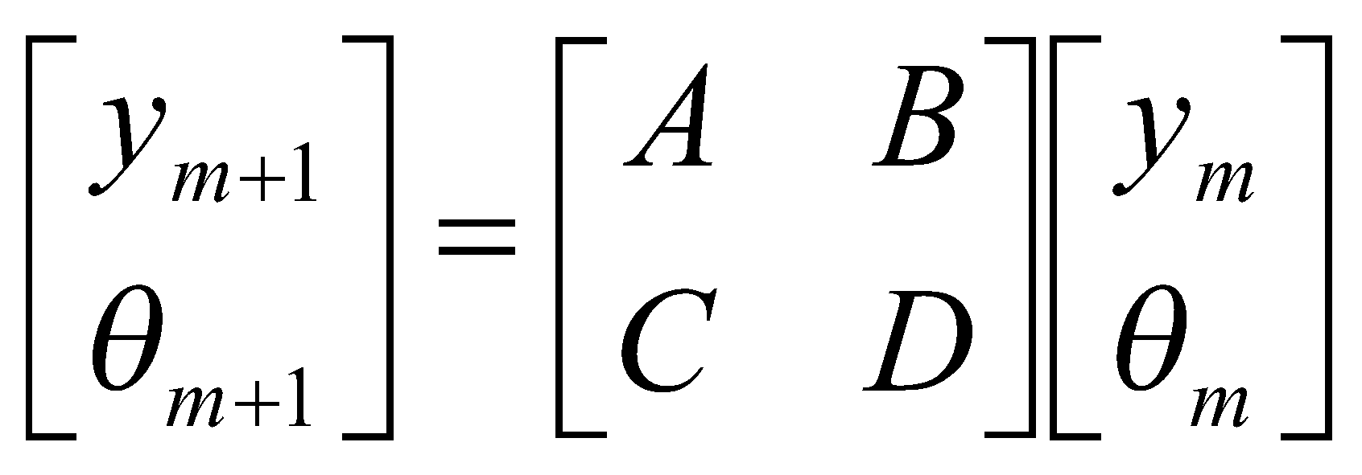
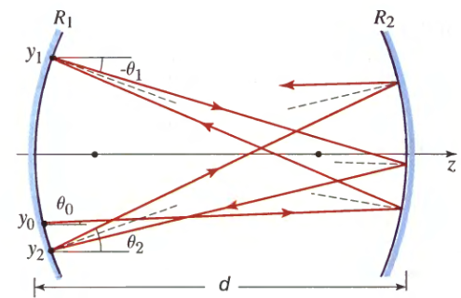
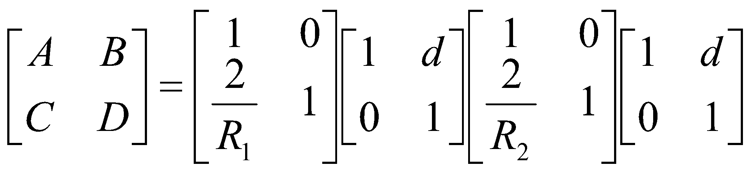
For paraxial rays, where all angles are small,
This cascade of ray-transfer matrices represents, from right to left :
Propagation a distance d through free space.
Reflection from a mirror of radius R_{2.}
Propagation a distance d through free space.
Reflection from a mirror of radius R₁ .
Beginning at the bottom-left with y_{o} and θ_{o}, the round-trip ray-transfer matrix will be

Slide 5
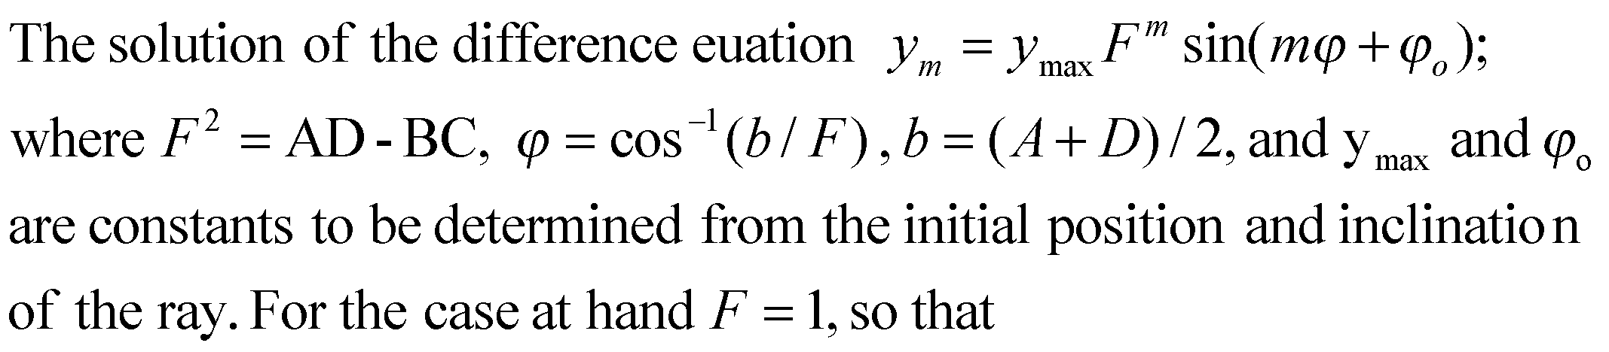
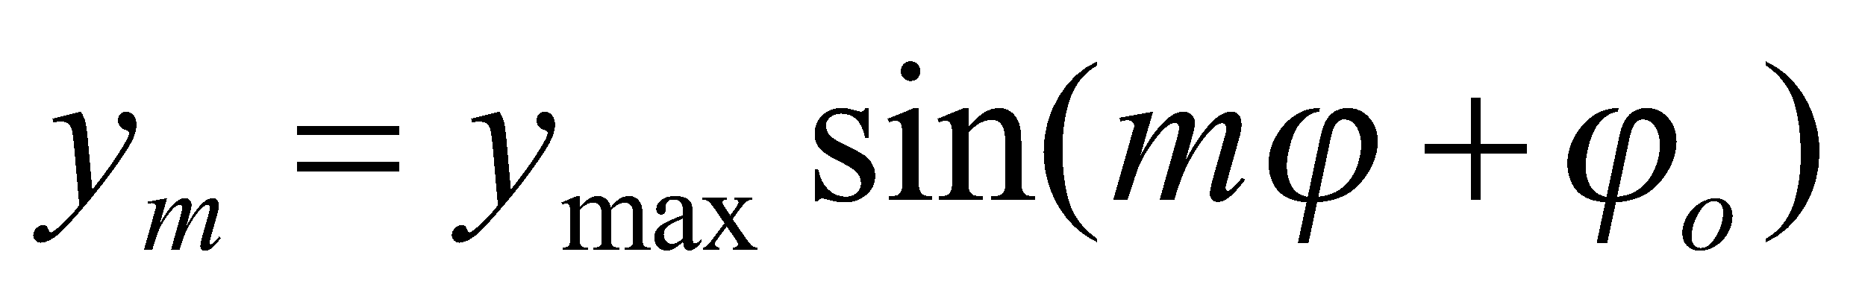
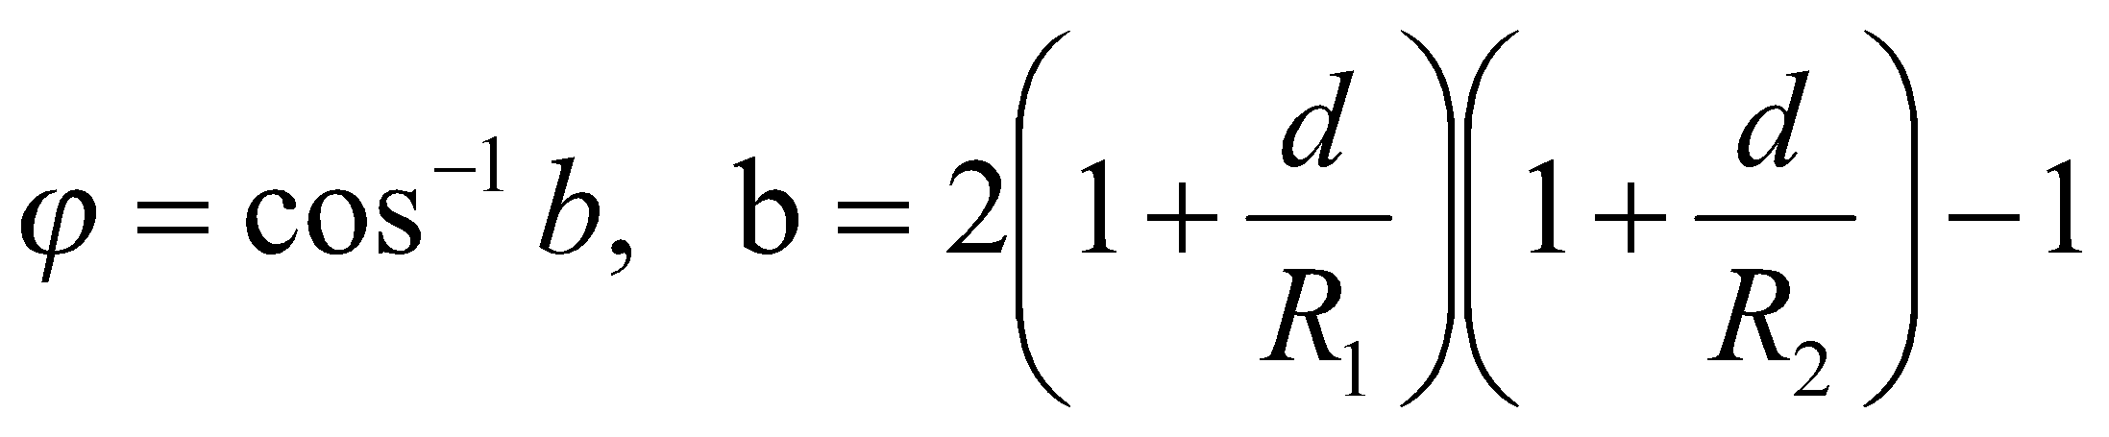
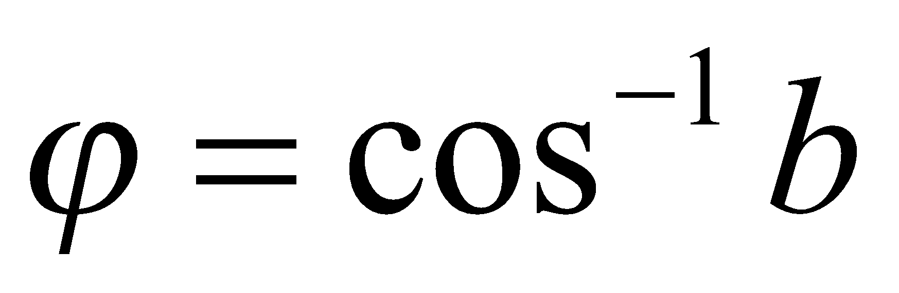
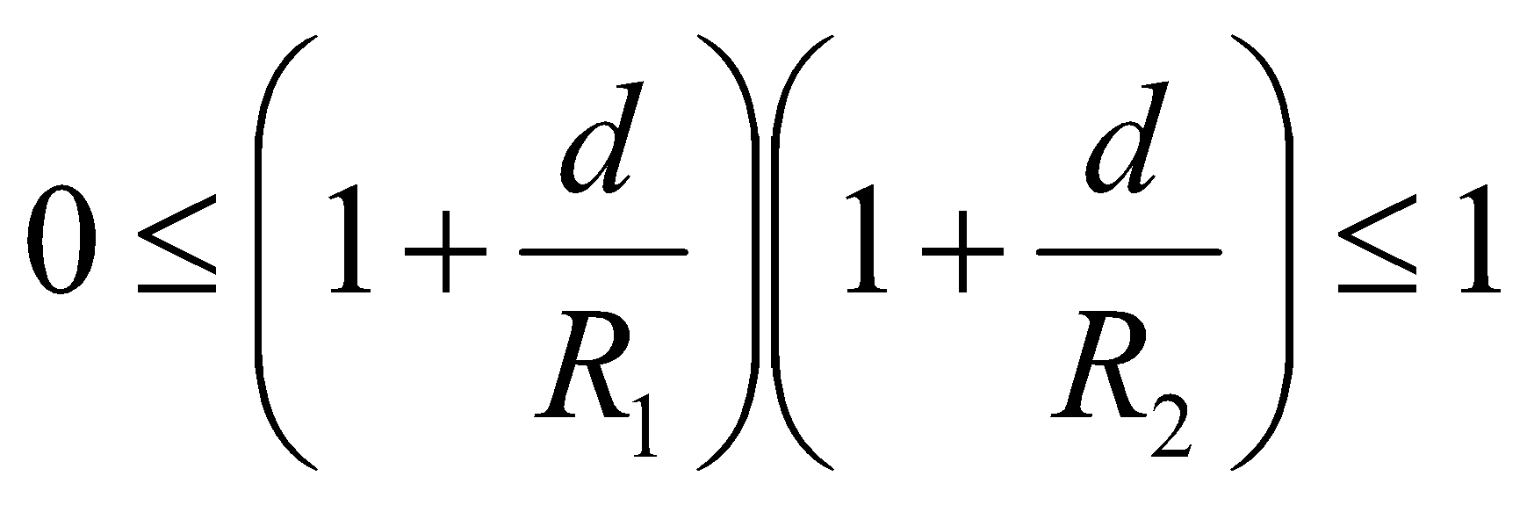

The solution is harmonic, and therefore bounded, provided
is real. This is ensured if |b|≤ 1 , i.e., if -1 < b < 1, so that
rewrite this condition in terms of the quantities
g1 =1 + d / R 1 and g2 = 1 + d / R 2 ,
which are known as the g parameters:
Confinement condition
(Stable resonator)

Slide 6
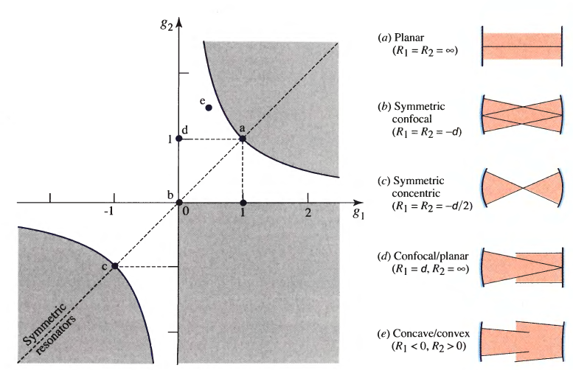
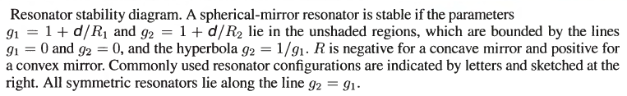

Slide 7
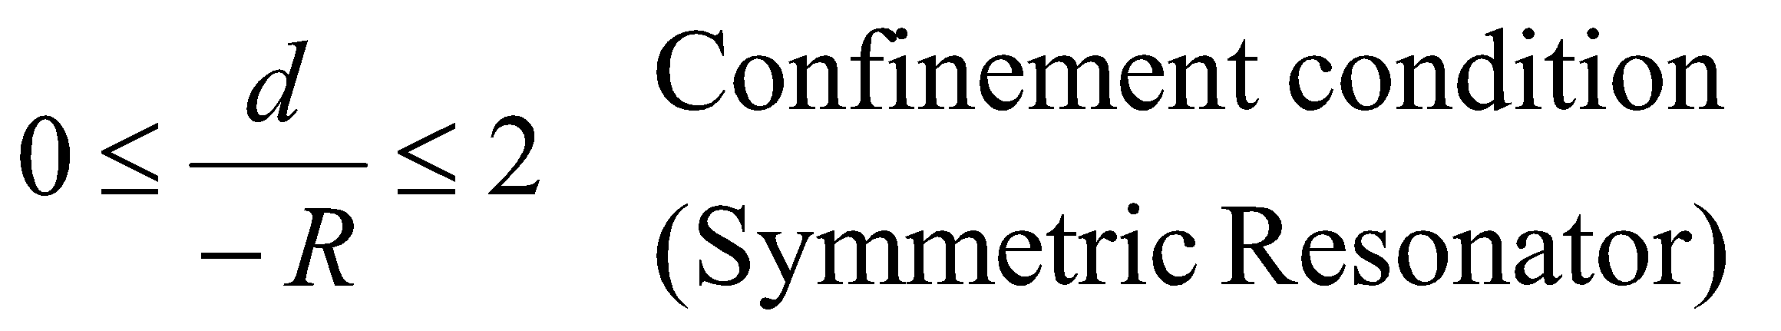
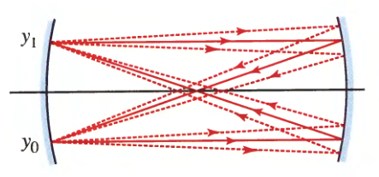
Symmetric resonators, by definition, have identical mirrors (R 1 == R 2 == R) so that g1=g2. Resonators in this class are lying along the line g2 =g1. The condition of stability then becomes g² ≤ 1, or -1 ≤ 1 + d/ R ≤ 1, which implies
d /(- R) = 0, 1, and 2, corresponding to planar, confocal, and concentric resonators, respectively.
In the symmetric confocal resonator, (- R) = d so that the center of curvature of each mirror lies on the other. Thus, b = -1 and ϕ=π. All paraxial rays are therefore confined, whatever their original position and inclination.

Slide 8
Summary
The confinement condition for paraxial rays in a spherical-mirror resonator, comprising mirrors of radii R₁ and R₂ separated by a distance d, is 0 ≤ g₁g₂ ≤ 1, where g₁= 1 + d/R₁ and g₂= 1 + d /R₂ . The confinement condition for symmetric resonators is 0 ≤ d/(-R) ≤2; this condition governs planar, symmetric confocal, and symmetric concentric mirror configurations.

